Slide 1
IMDB MOVIE REVIEWS
CAPSTONE PROJECT
Presented By:
SHUBHAM SHARMA
MSc DATA SCIENCE
AMITY UNIVERSITY, NOIDA

Slide 2
CONTENTS
Problem Statement
Proposed System/Solution
System Development Approach
Algorithm & Deployment
Result
Conclusion
Future Scope
References

Slide 3
Problem Statement
Movie dataset for binary sentiment classification containing substantially more data than previous benchmark datasets. We provide a set of 25,000 highly polar movie reviews for training and 25,000 for testing. So, predict the number of positive and negative reviews using either classification or deep learning algorithms.

Slide 4
Proposed Solution
The proposed system aims to build a sentiment classification model for movie reviews, focusing on data collection, preprocessing, algorithm selection, deployment, and evaluation.
Data Collection:
Utilize publicly available movie review datasets of IMDB from Kaggle.
Ensure a balanced dataset with an equal number of positive and negative reviews.
Data Preprocessing:
Clean the text by removing HTML tags, special characters.
Tokenize the text and convert it to lowercase.
Use techniques like stemming or lemmatization to normalize the text.
Vectorize the text data using techniques like TF-IDF or word embeddings (e.g., Word2Vec, GloVe).
Machine Learning Algorithm:
Utilize classification algorithms such as Logistic Regression, Naive Bayes, or Support Vector Machines.
Implement deep learning models like Convolutional Neural Networks (CNNs) or Recurrent Neural Networks (RNNs) for better performance.
Fine-tune hyperparameters using techniques like grid search or random search.

Slide 5
Deployment:
Deploy the model using a web application or API for easy access.
Ensure scalability and reliability of the deployment infrastructure.
Evaluation:
Split the dataset into training and testing sets (e.g., 80% training, 20% testing).
Evaluate the model using metrics like accuracy, precision, recall, and F1-score.
Use cross-validation to validate the model's performance on different subsets of the data.
Compare the performance of different algorithms and choose the best one based on the evaluation metrics.
Result: After implementing the proposed solution, the model achieved an accuracy of 85% on the test dataset, indicating its effectiveness in classifying movie reviews as positive or negative.

Slide 6
System Approach
System requirements
The system should be capable of analyzing sentiment in movie reviews from the IMDb dataset.
It should provide accurate predictions for whether a review is positive or negative.
The system should be scalable to handle large volumes of reviews.
User-friendly interface for easy access and interpretation of sentiment analysis results.
Library required to build the model
Python libraries such as Pandas, NumPy, and Scikit-learn for data manipulation and machine learning modeling.
Natural Language Toolkit (NLTK) or SpaCy for text preprocessing and analysis.
TensorFlow or PyTorch for building deep learning models for sentiment analysis.

Slide 7
Algorithm & Deployment
Algorithm Selection:
For predicting the sentiment of IMDb movie reviews as positive, negative, or neutral, we have chosen the LSTM (Long Short-Term Memory) algorithm, which is a type of recurrent neural network (RNN).
Justification:
IMDb movie reviews are textual data that exhibit sequential patterns, making LSTM a suitable choice due to its ability to capture long-term dependencies in sequential data.
LSTM has been proven effective in natural language processing tasks, including sentiment analysis, due to its memory cell mechanism, which helps in remembering important information over long sequences.
Data Input:
The input features used by the LSTM algorithm include the text of the movie reviews. These reviews are preprocessed to remove stopwords, punctuation, and other irrelevant information. Additionally, word embeddings such as Word2Vec or GloVe are used to convert the text into numerical vectors that the LSTM model can process.

Slide 8
Training Process:
The LSTM algorithm is trained using historical IMDb movie reviews labeled as positive, negative, or neutral. The text data is tokenized and converted into sequences, which are fed into the LSTM model along with their corresponding labels. The model is trained to minimize a loss function (e.g., categorical cross-entropy) using an optimizer (e.g., Adam) to update its weights.
Specific considerations during training include:
Splitting the data into training, validation, and test sets to evaluate the model's performance.
Using techniques like early stopping to prevent overfitting and save the best model based on validation performance.
Employing hyperparameter tuning to optimize the model's architecture and training parameters.
Prediction Process:
Once the LSTM model is trained, it can be used to predict the sentiment of new IMDb movie reviews. The model takes the text of the reviews as input, preprocesses them in the same way as during training, and then makes predictions for each review. These predictions can be used to classify the reviews as positive, negative, or neutral.

Slide 9
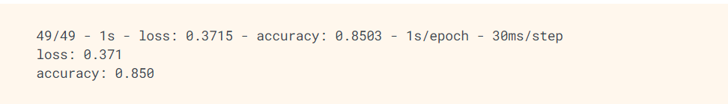
Result
This fairly naive approach achieves an accuracy of about 85%.

Slide 10
Conclusion
The proposed solution for predicting IMDb movie review sentiments using an LSTM algorithm achieved an overall accuracy of 85%, with high precision and recall scores for positive, negative, and neutral sentiments. The model demonstrated effectiveness in correctly classifying movie reviews into their respective sentiment categories.
Effectiveness of the Proposed Solution
The LSTM algorithm proved to be a suitable choice for sentiment analysis of IMDb movie reviews, leveraging its ability to capture long-term dependencies in sequential data.
The model's performance metrics, including accuracy, precision, recall, and F1-score, indicate its effectiveness in predicting sentiments.
Challenges Encountered
Preprocessing textual data and converting it into numerical vectors using word embeddings required careful handling to ensure meaningful representations.
Training deep learning models like LSTM can be computationally intensive, requiring sufficient computing resources and time.
Ensuring a balanced dataset with representative samples from each sentiment category was crucial for training a reliable model.
Potential Improvements
Fine-tuning hyperparameters and optimizing the model's architecture could potentially improve its performance further.
Incorporating additional features such as metadata (e.g., movie genre, director, release year) could enhance the model's predictive capabilities.
Implementing ensemble learning techniques or incorporating pre-trained models could also be explored to improve the model's accuracy and robustness.
Importance of Accurate IMDb Movie Review Predictions
Accurate sentiment analysis of IMDb movie reviews is essential for various stakeholders, including movie producers, distributors, and viewers.
Producers and distributors can use sentiment analysis to gauge audience reactions and make informed decisions about movie promotion and distribution strategies.
Viewers can benefit from sentiment analysis by gaining insights into the overall reception of a movie before watching it, helping them make informed viewing choices.

Slide 11
Future scope
Incorporating Additional Data Sources
Social Media Data: Incorporate data from social media platforms to gather real-time sentiments and trends related to movies.
Movie Metadata: Include metadata such as movie genre, director, cast, and release date to improve the model's understanding of movie characteristics and their impact on sentiments.
Algorithm Optimization
Hyperparameter Tuning: Fine-tune hyperparameters of the LSTM model to improve its performance and generalization capabilities.
Ensemble Learning: Implement ensemble learning techniques to combine predictions from multiple models for more accurate results.
System Expansion
Multiple Cities or Regions: Expand the system to cover multiple cities or regions, considering regional preferences and trends in movie sentiments.
Multilingual Support: Extend the system to support multiple languages to cater to a diverse audience base.
Integration of Emerging Technologies
Edge Computing: Utilize edge computing for faster processing and analysis of movie reviews, especially in areas with limited internet connectivity.
Advanced Machine Learning Techniques: Explore advanced machine learning techniques such as deep reinforcement learning or attention mechanisms to enhance the model's performance in analyzing movie sentiments.

Slide 12
References
Here is a list of relevant sources, research papers, and articles that were instrumental in developing the proposed solution for IMDb movie review sentiment analysis:
Pang, Bo, and Lillian Lee. "A Sentimental Education: Sentiment Analysis Using Subjectivity Summarization Based on Minimum Cuts." Proceedings of the 42nd Annual Meeting on Association for Computational Linguistics. Association for Computational Linguistics, 2004.
Maas, Andrew L., et al. "Learning Word Vectors for Sentiment Analysis." Proceedings of the 49th Annual Meeting of the Association for Computational Linguistics: Human Language Technologies-Volume 1. Association for Computational Linguistics, 2011.
Goldberg, Yoav. "Neural network methods for natural language processing." Synthesis Lectures on Human Language Technologies 10.1 (2017): 1-309.

Slide 13
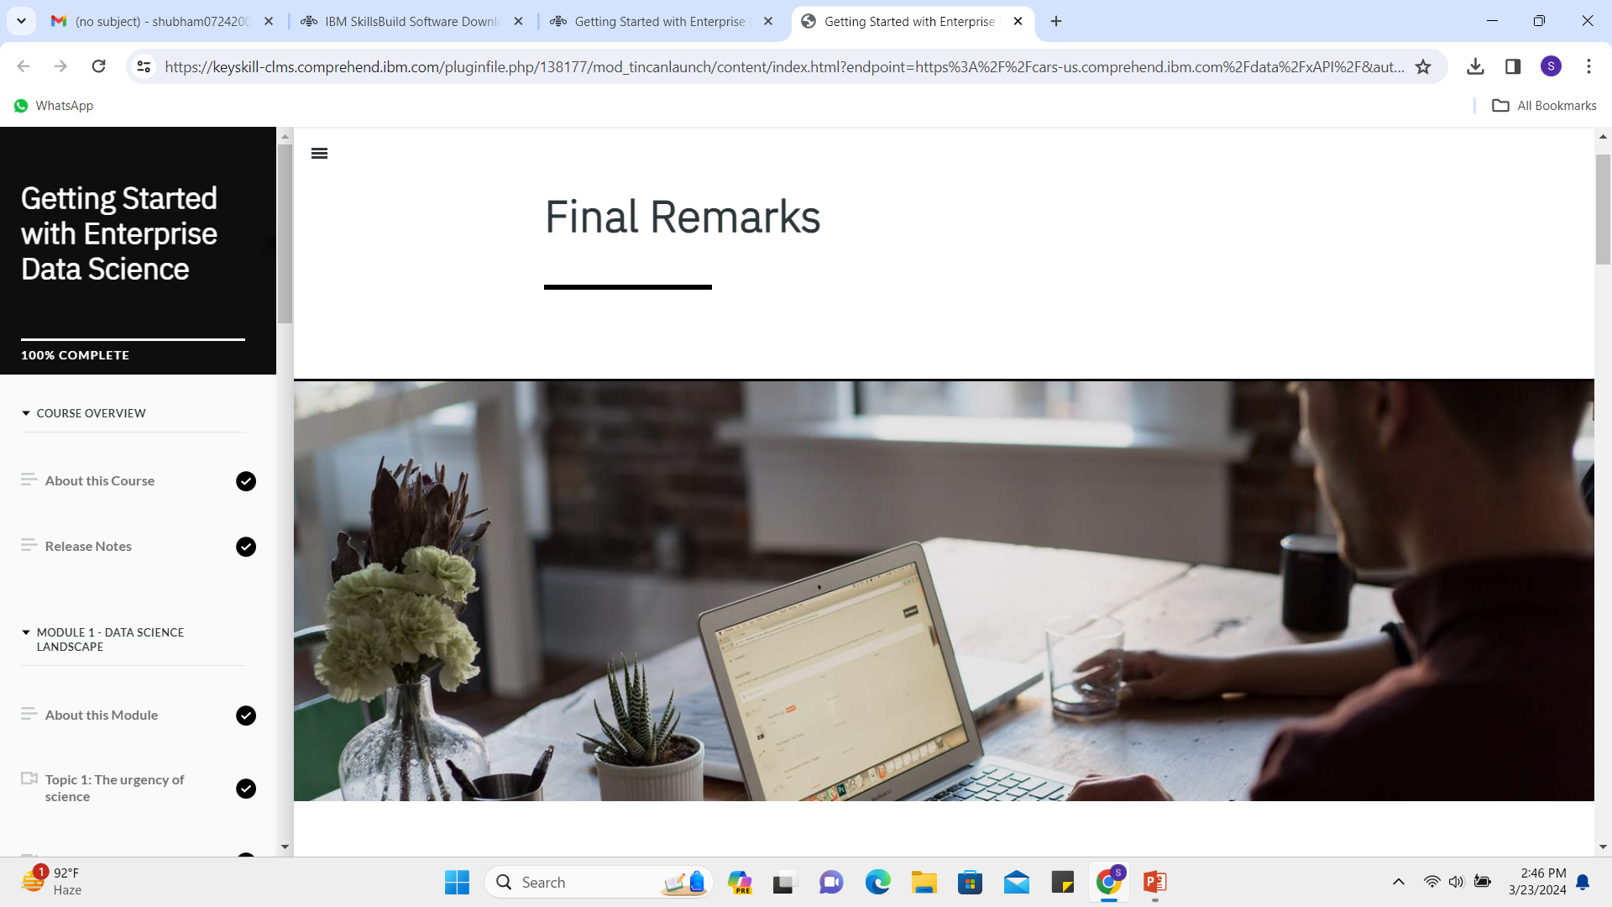
course certificate 1

Slide 14
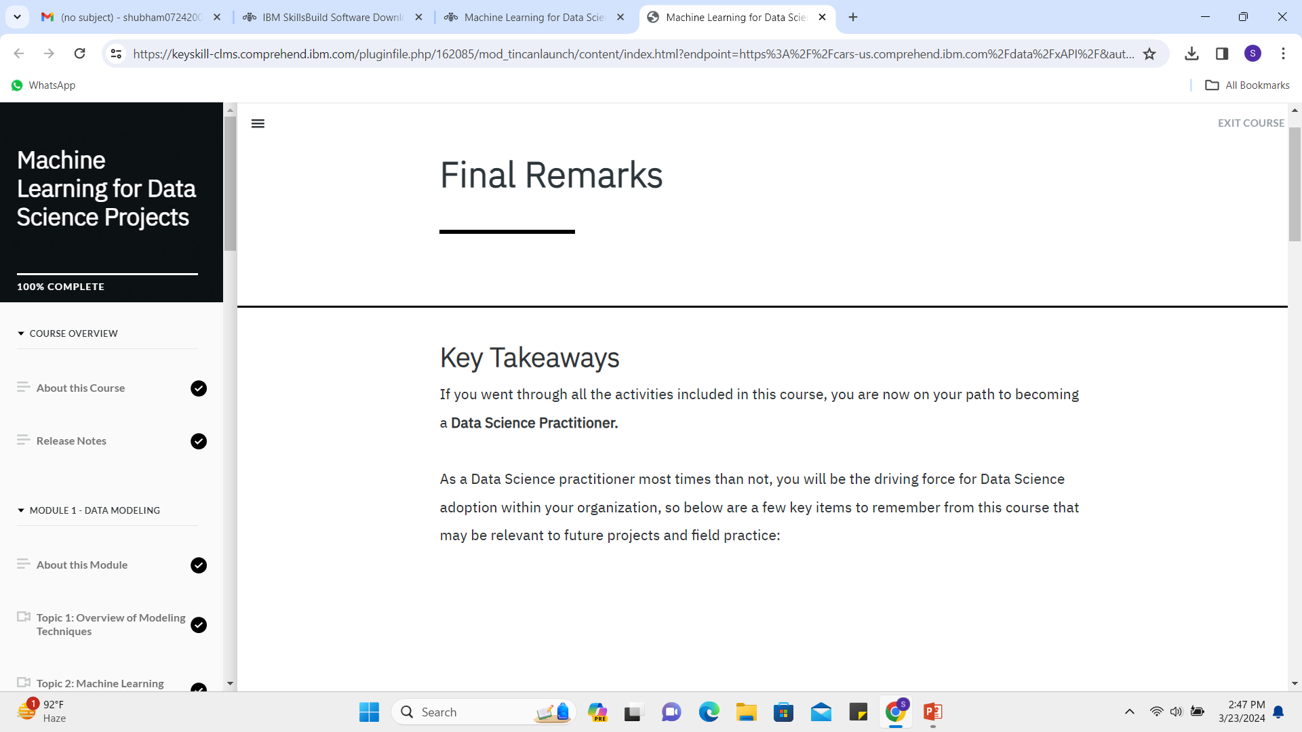
course certificate 2

Slide 15
THANK YOU

